Slide 1
Avanade CRM TC Academy
Week 5, Custom Application & Web API
Marzo 2018

Slide 2
Agenda
Dynamics 365 CE Extensibility Model
Dynamics 365 Web API
OAuth
Dynamics 365 SDK & Tooling
Console Apps
Setup
“Best” practices
No Framework
Avanade.XRM.Batches
XRM Toolbox Plugin
Hands-on Lab

Slide 3
La prima regola dell’Academy… E’ che si parla di Dynamics 365 CE, quando vuoi ☺
Domande
Ogni momento è buono per fare domanda, chiarire dei dubbi e intavolare una discussione
Pause
Quando vi sentite full alzate la mano, ne parliamo e cerchiamo di organizzarci al meglio, in modo da rispettare i ritmi di tutti
FIRMATE IL FOGLIO DELLE PRESENZE

Slide 4











Integrated
Applications
Front End Integration
Reporting
(Dashboards, Charts, Excel, FetchXML and SRS)
USD
Web
Outlook
Mobile
Extensible Application: Form and client
side events, Ribbon, Sitemap,
Web Resources, JS libraries…
Web Services
Back End Integration
server-to-server
Pre-Event Plug-ins
(.NET Assemblies)
Post-Event Plug-ins
(.NET Assemblies)
Custom Workflow
(.NET Assemblies)
Synchronous and Asynchronous Business Logic
Business Entity Components
Security
Workflow
Data Access Components
Data Access Platform
Filtered SQL Views
Metadata
Data
Notes:
USD and CRM Conceptual Architecture

Slide 5
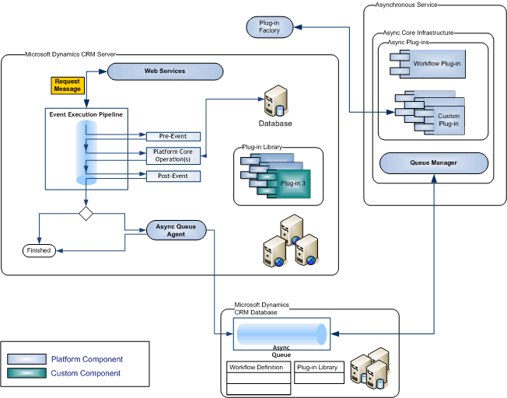
Dynamics 365 Sync/Async event processing pipeline

Slide 6
Dynamics 365 Web API: OAuth
OAuth is the authentication method supported by the Dynamics 365 for Customer Engagement apps Web API, and is one of two authentication methods for the Organization Service – the other being Active Directory authentication. One benefit of using OAuth is that your application can support multi-factor authentication. You can use OAuth authentication when your application connects to either the Organization service or the Discovery service.
Method calls to the web services must be authorized with the identity provider for that service endpoint. Authorization is approved when a valid OAuth 2.0 (user) access token, issued by Azure Active Directory, is provided in the headers of the message requests.
The recommended authentication API for use with the Customer Engagement Web API is Azure Active Directory Authentication Library (ADAL), which is available for a wide variety of platforms and programming languages. The ADAL API manages OAuth 2.0 authentication with the Customer Engagement web service identity provider.

Slide 7
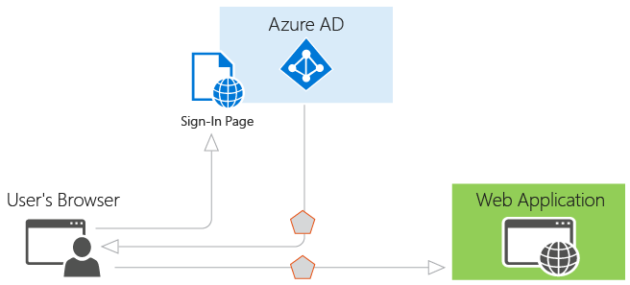
What is authentication?
Authentication is the act of challenging a party for legitimate credentials, providing the basis for creation of a security principal to be used for identity and access control. In simpler terms, it's the process of proving you are who you say you are.
Authorization is the act of granting an authenticated security principal permission to do something. It specifies what data you're allowed to access and what you can do with it.

Slide 8
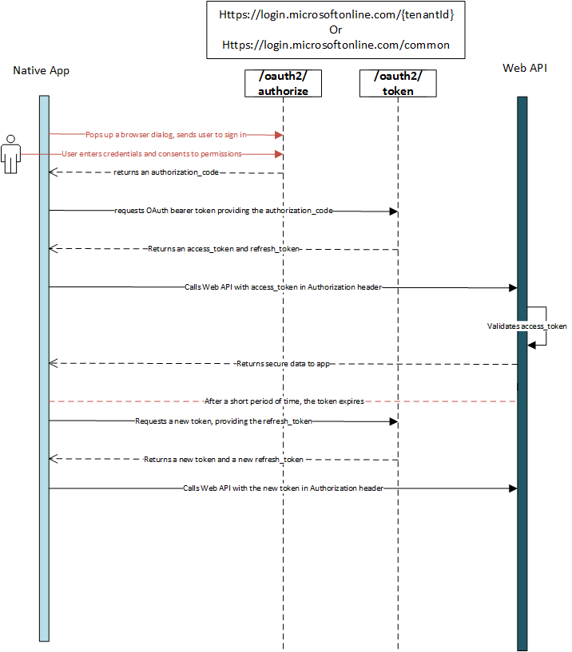
OAuth 2.0 Flow
Azure Active Directory (Azure AD) uses OAuth 2.0 to enable you to authorize access to web applications and web APIs in your Azure AD tenant. This guide is language independent, and describes how to send and receive HTTP messages without using any of our open-source libraries.
The OAuth 2.0 authorization code flow is described in section 4.1 of the OAuth 2.0 specification. It is used to perform authentication and authorization in most application types, including web apps and natively installed apps.

Slide 9
It all starts with the SDK…
Download: https://www.microsoft.com/en-us/download/details.aspx?id=50032
Al suo interno sono contenuti:
Code Samples (C#, VB.NET)
Image Assets – utili per le personalizzazione frontend (UI consistency)
CHM document – obsoleto, meglio la documentazione online
Tools
Data Configuration Migrator
Plugin Registration Tool
Solution Deployer
Visual Studio Templates (compatibili con VS2017!!)
Metadata Browser

Slide 10
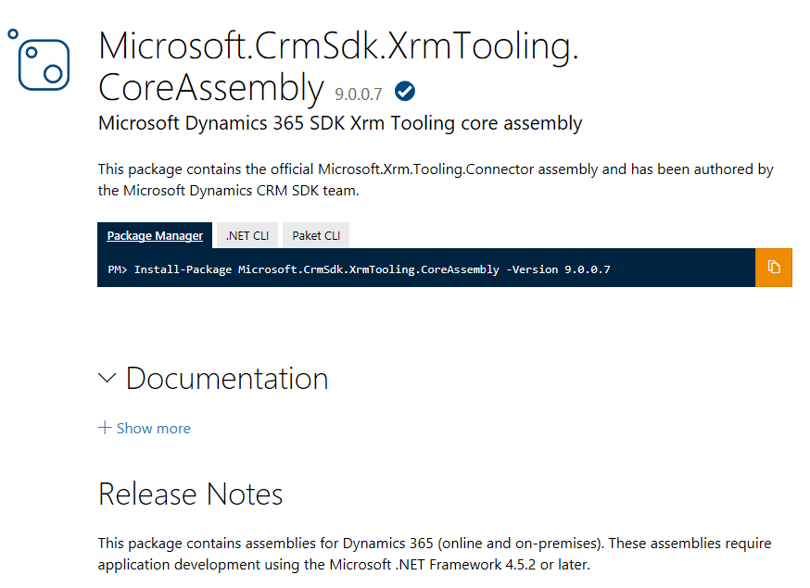
NuGet to the rescue
.NET Framework | SDK Client | Dynamics CRM versions | Description
.net 4.0 | CRM 2013 (6.x) Download here | v6.x, v7.x, & v8.x | Supported with new Microsoft.Xrm.Sdk.dll assembly included in: Dynamics CRM 2013 SDK Version 6.1.2, January 2017 NuGet Package: Microsoft.CrmSdk.CoreAssemblies Version 6.1.2
.net 4.5.2 | CRM 2015 (7.x) Download here | v6.x, v7.x, v8.0 & v8.1.0 | Supported* *v8.1.1+ is not supported, Move to SDK version 8.x for support for CRM version 8.1.1+
.net 4.5.2 | CRM 2016 (8.x) Download here

Slide 11
Hands on Labs
Application Security
Creaiamo una Web App protetta da Azure AD “federata” con Dynamics 365
Application users & On Behalf of
Console Application
In questo HOL cerchiamo di entrare nel dettaglio dell’SDK managed di Dynamics 365.
Proviamo a impostare un semplice gestionale CRUD su una nostra entity custom
Analizziamo best practices, librerie esterne utili e convenzioni
Avanade.XRM.Batches
Il nostro asset interno, configuriamo Visual Studio per utilizzarlo
Convertiamo la nostra Console App in Batch
Analizziamo il codice sorgente dell’asset
Contribuire ed estendere gli asset aziendali
«No Framework»
Interfacciamoci con Dynamics 365 senza SDK

